Slide 1
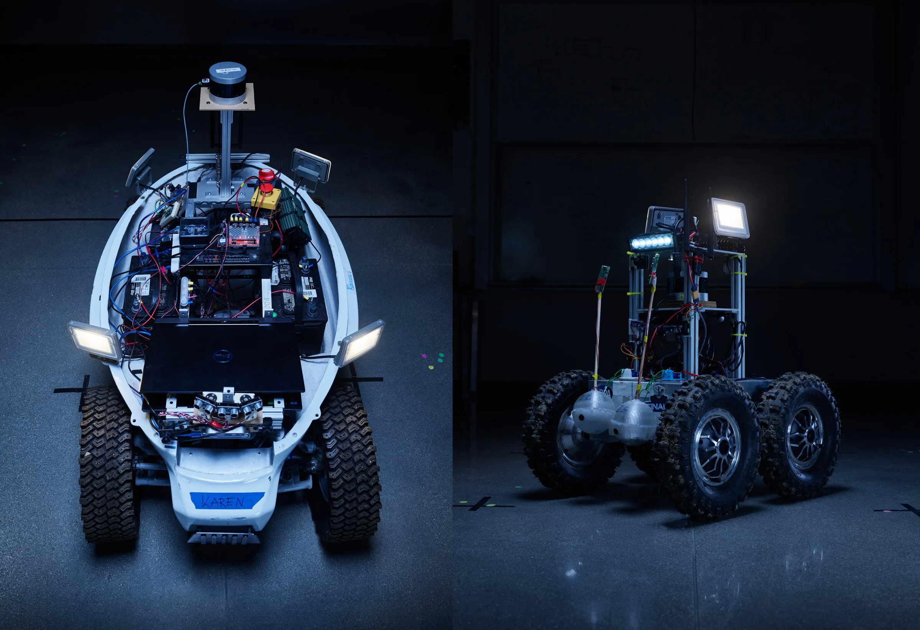
Applying Kalman Filter on Differential drive
Group members;
Shahir Anzal
Zaeem Baig

Slide 2
Outline
An overview of the project and its goals
The challenges we faced and how we overcame them
A detailed explanation of our approach to applying the Kalman filter (code)
Visualizations or data that demonstrate the effectiveness of our approach
A summary of the key results and findings of our work
A discussion of any future work you plan to do on the project

Slide 3

Introduction;
In Differential drive state estimation is an important problem, as it is essential for enabling mobile robots to navigate and perform other tasks accurately and effectively.
To estimate the state of a differential drive system, multiple sensors such as encoders , Lidar and GPS are typically used to measure the motion of the robot.
These measurements can be noisy, incomplete, or uncertain, however, so they must be processed and filtered to produce accurate state estimates.
This is where techniques such as Kalman filtering can be useful. Kalman filtering is a mathematical algorithm that can be used to estimate the state of a system based on noisy, incomplete, or uncertain data.

Slide 4
The challenges we faced
Identifying states and inputs
Relating the inputs with model used
Noise modelling and finding its covariance
Researching and selecting appropriate measurement model
Coding the actual plant and its measurement model
Code the kalman filter algorithm in Matlab

Slide 5
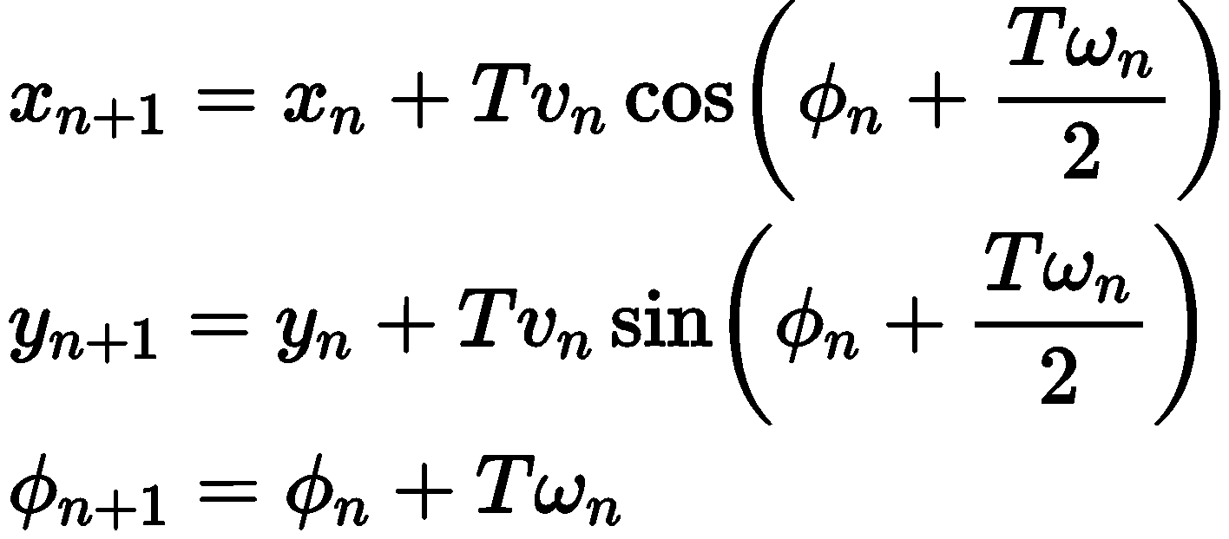
Our Approach
Initially we have a kinematic model which we discretized using geometric approach found in the literature
Then we identified our states as (v and omega) which is linear
We created state space model relating v and omega with our inputs and some random noise
Then we used basic measurement model where sensors gave the wheel velocities with some random noise

Slide 6
Applying Kalman filter
By applying a kalman filter to the sensor data from a differential drive system, it is possible to improve the accuracy of the system's state estimates and make the system more responsive to changes in its environment.
To implement Kalman filter first we understood the algorithm which is derived from recursive Bayesian Approach.

Slide 7
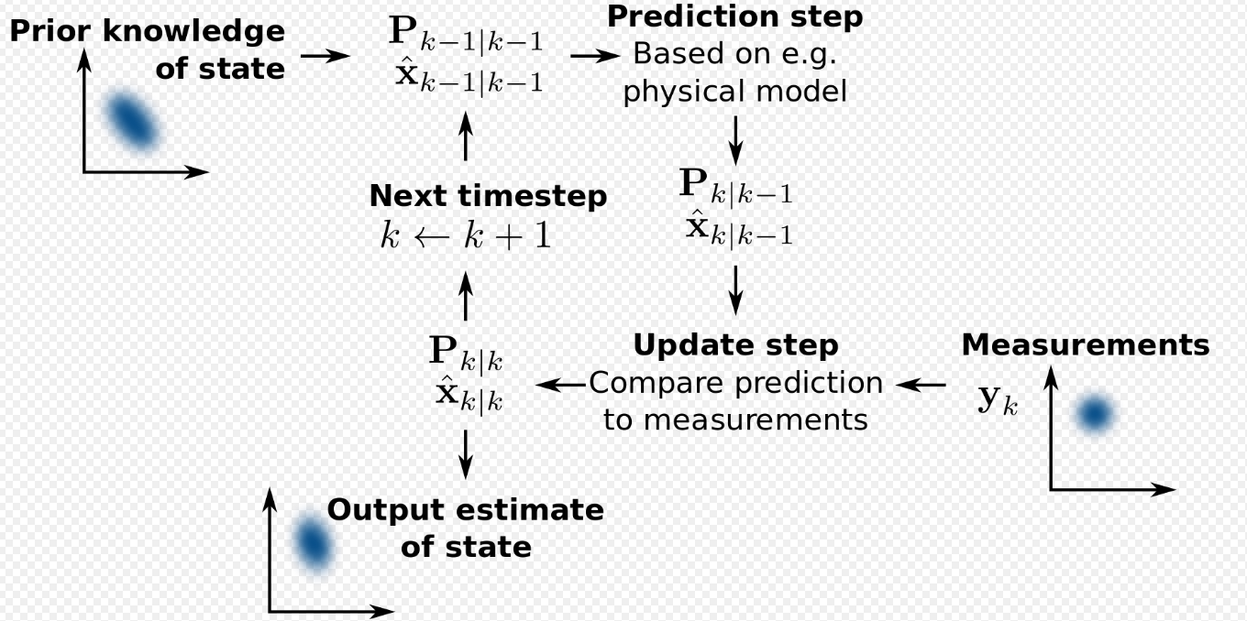
Applying Kalman filter

Slide 8
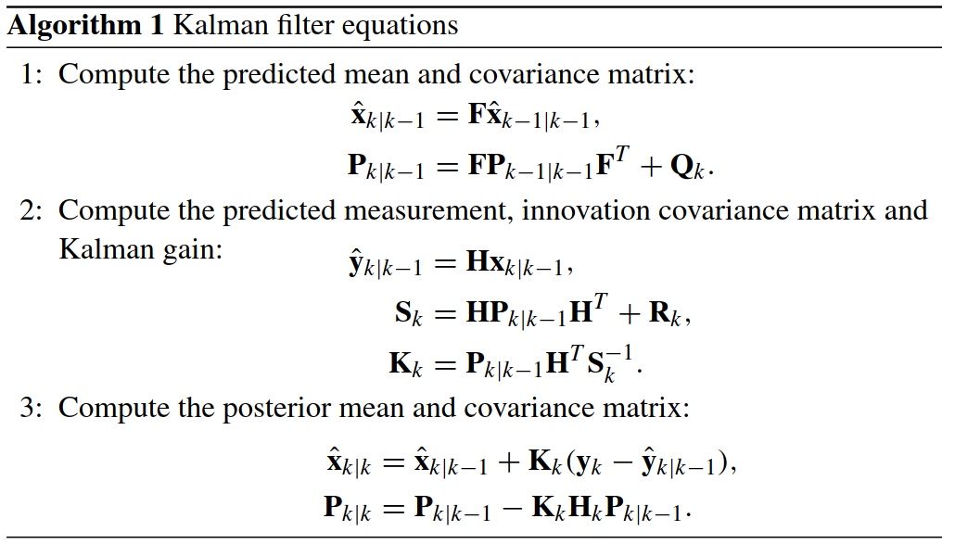
Kalman filter Algorithm

Slide 9
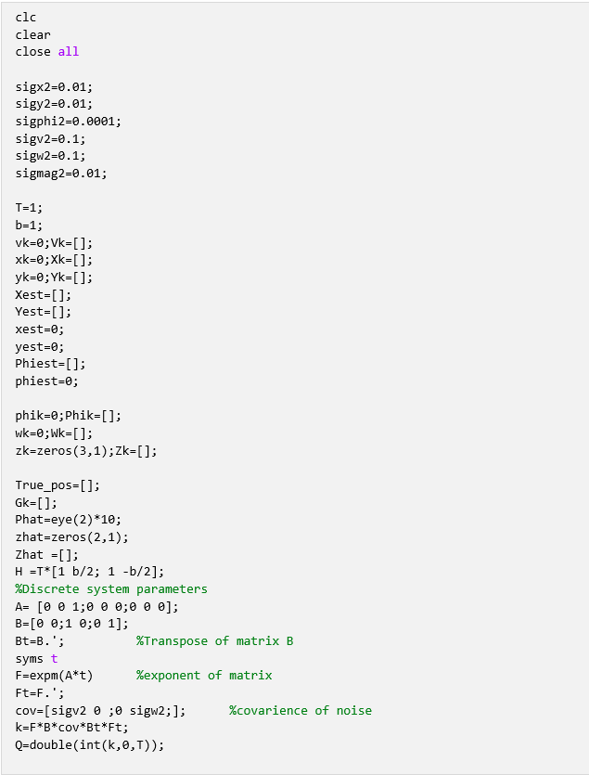
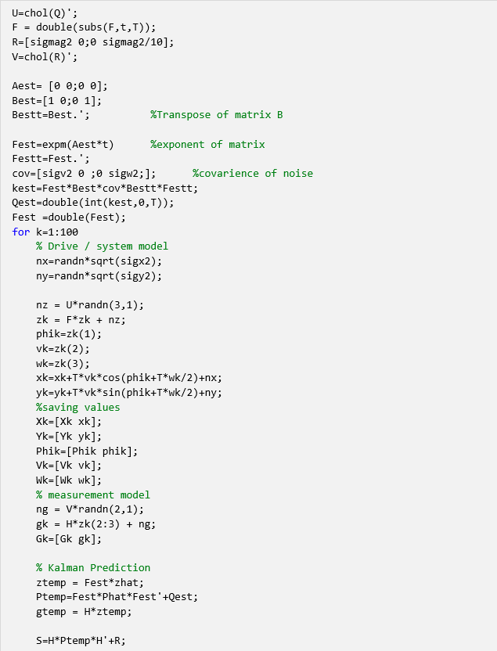
Code

Slide 10
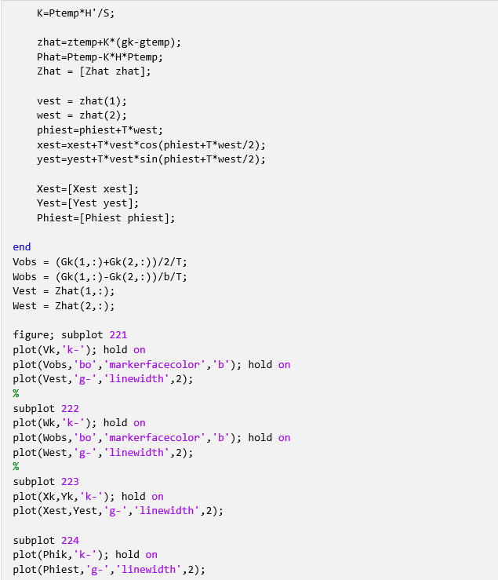

Slide 11
Results

Slide 12
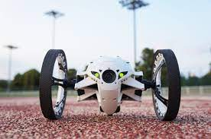
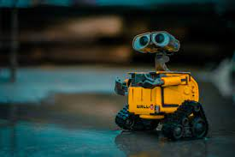
Future work
Use better and more accurate model
1
Work on our approach to find accurate trajectory
2
Visual based localization and correction
3

Slide 13

Thank you

